Slide 1


2026
National K-12 Student Ceramic Works
Guidelines for presentation

Slide 2
Instructions for teachers
We would appreciate it if you follow these instructions for submitting your photos. This will make the compilation of the digital presentation easier for the Clay Gulgong team.
Make a copy of this sample presentation. (File > Make a copy)
Change the title to the name of your school
Up to five slides per school in total
No more than 3 works per slide from the one year group.
Works can be from a range of year groups or all from the same year group
Please use the format in the slide presentation only including font style and design. Do not alter these.
Photographs need to be taken against a plain white or plain black background only. Images should be 300dpi and in jpeg format
Please do not include shots that include images of students at all or art room spaces.

Slide 3
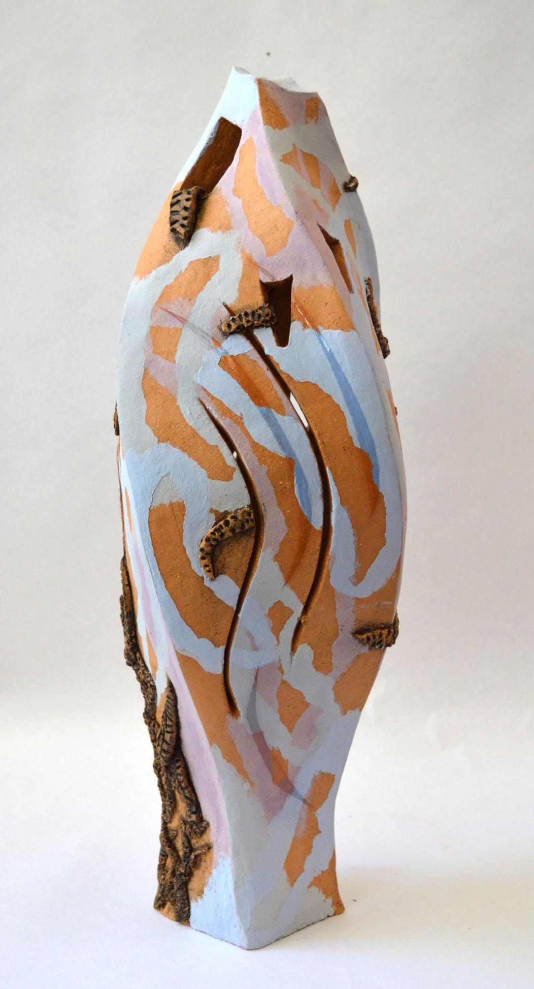
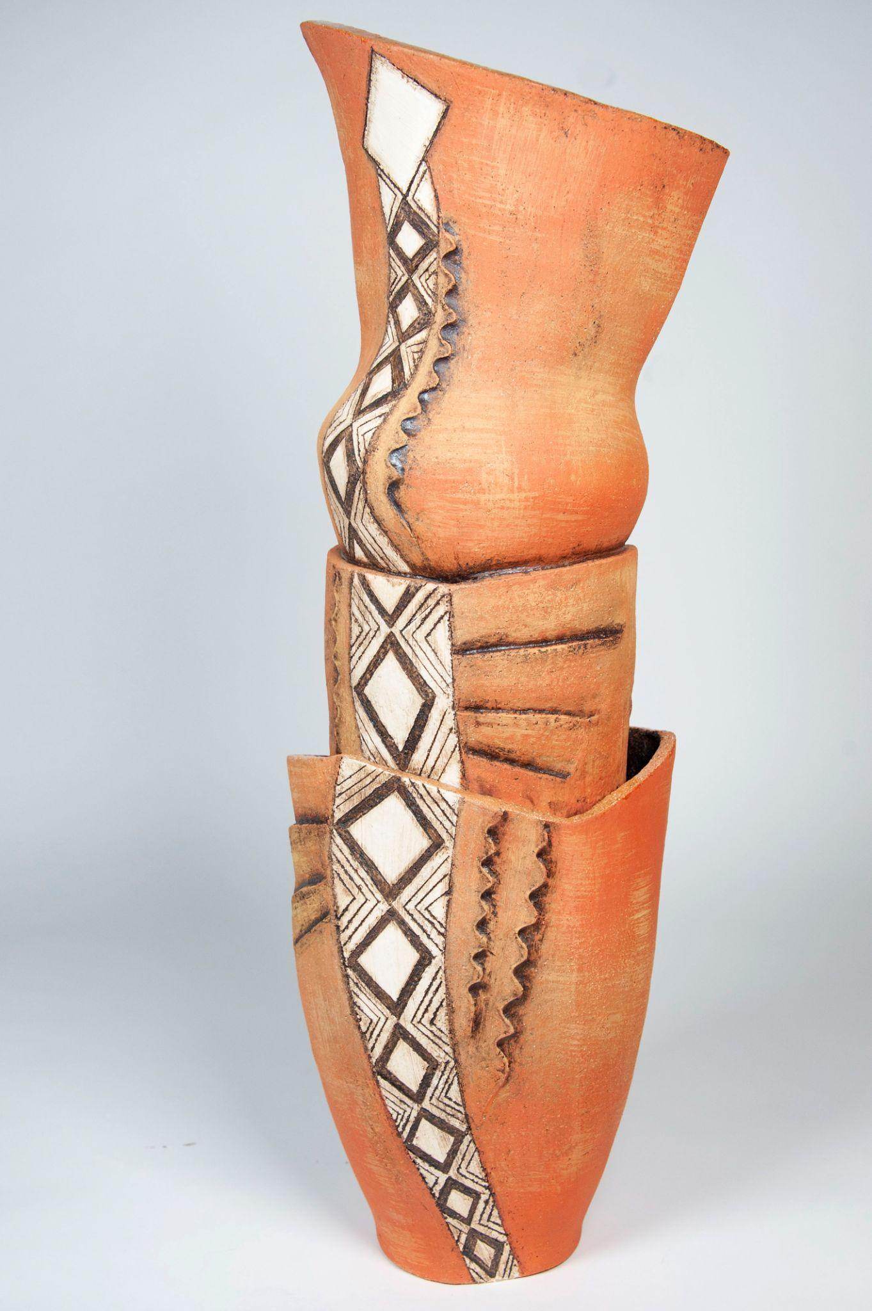
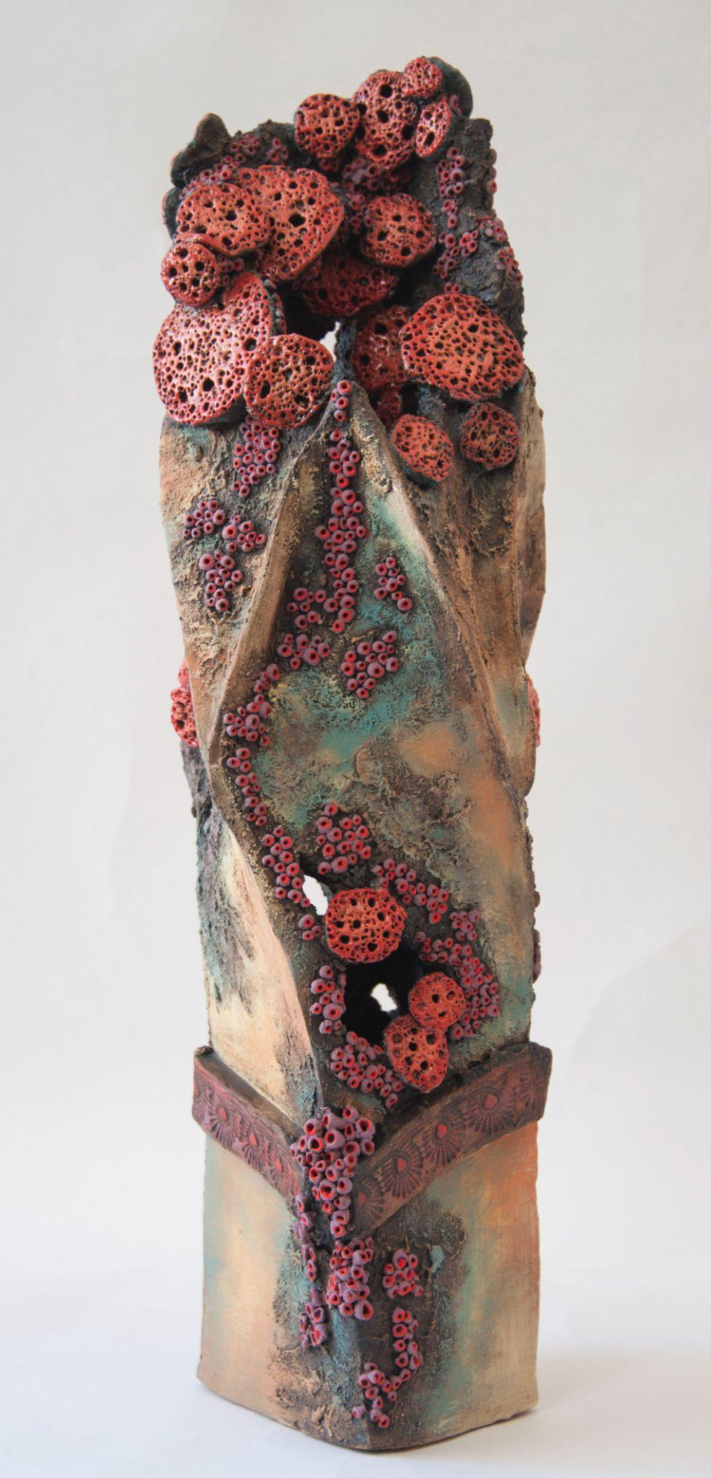
School Name, State, Year level
First name only
First name only
First name only

Slide 4
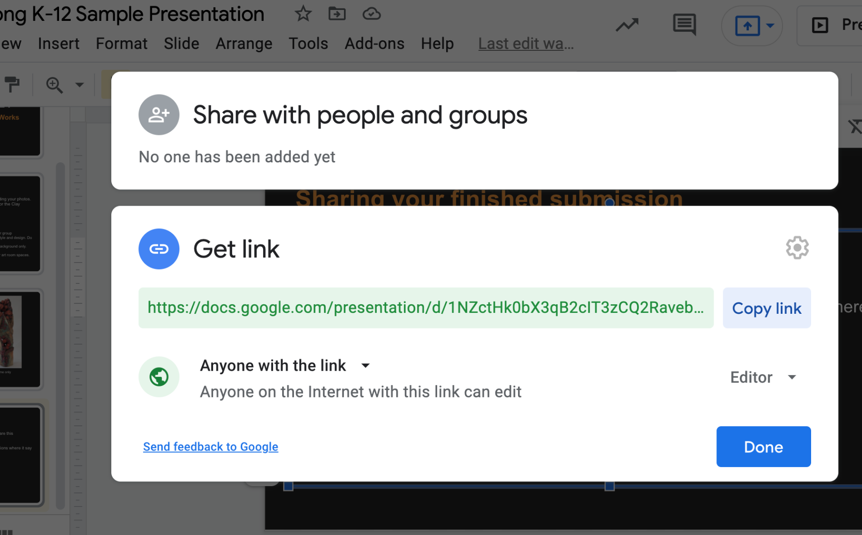
Sharing your finished submission
When you have finished adding your photos and information, share this presentation with the Clay Gulgong team via this email address.
K-12@claygulgong.com
When you share make sure that you change the access permissions.

